Slide 1
PWM Generator
Vlad Veliciu
Faculty of Electronics, Telecommunication and Information Technology, TUC-N

Slide 2

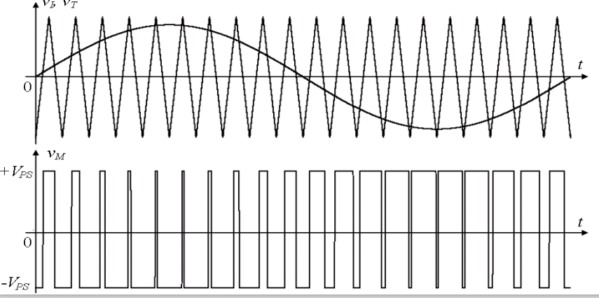
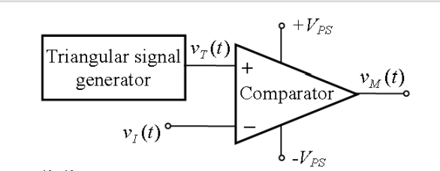
Description and functionality of the circuit
Design parameters:
Duty cycle: 10%-50%
Amplitude: 3V-5V
F=12000 Hz
Vi(t) can be a sine wave or a DC signal

Slide 3
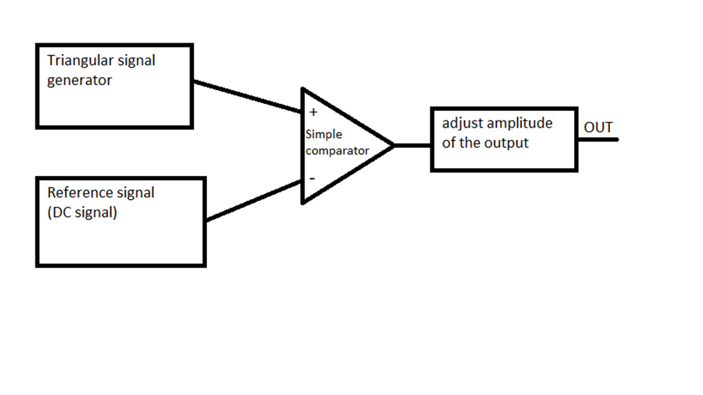
Block Diagram

Slide 4
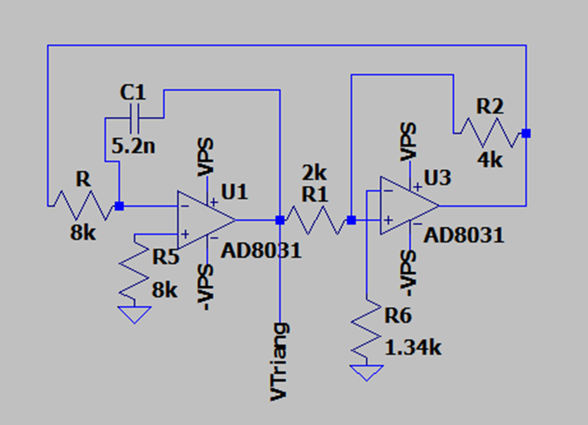
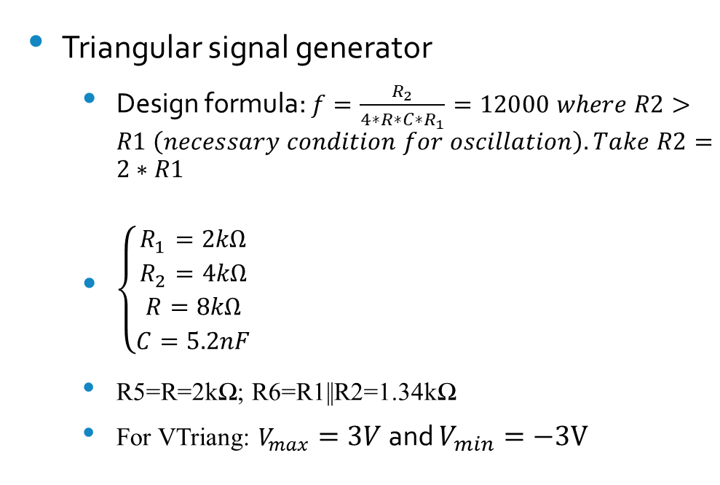
Electrical schematic and theoretically computed values for components
Triangular signal generator
Design formula: $f=\frac{R_{2}}{4∗R∗C∗R_{1}}=12000 where R2>R1 \left(necessary condition for oscillation\right). Take R2=2∗R1$
${{\left\{\begin{aligned}R_{1}=2kΩ \\ R_{2}=4kΩ \\ R=8kΩ \\ C=5.2nF\end{aligned}\right.}_{}}_{}$
R5=R=2kΩ; R6=R1||R2=1.34kΩ
For VTriang: $V_{max}=3V$ and $V_{min}=−3V$
VPS=6V

Slide 5
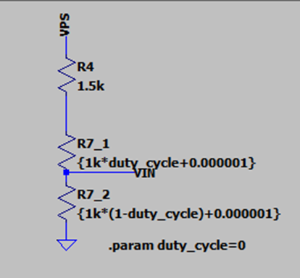
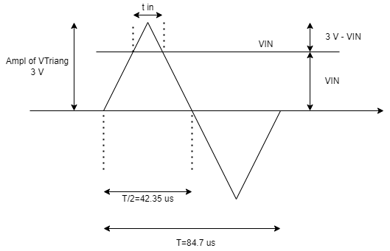

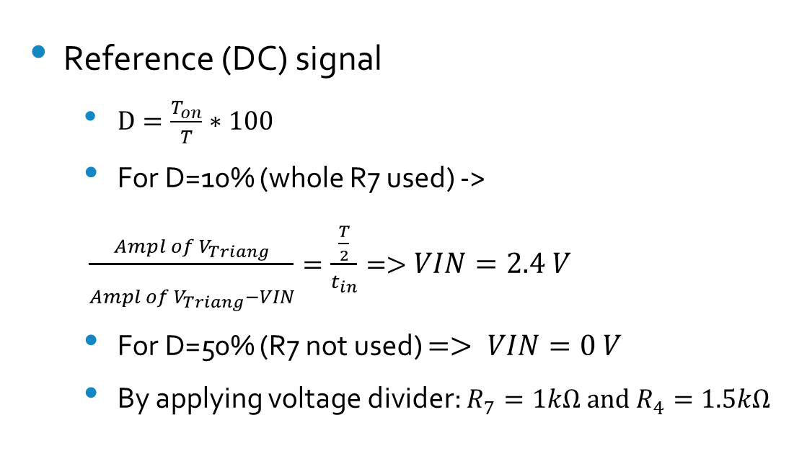
Electrical schematic and theoretically computed values for components
Reference (DC) signal
$D=\frac{T_{on}}{T}∗100$
For D=10% (whole R7 used) ->
$\frac{Ampl of V_{Triang}}{\begin{aligned} \\ Ampl of V_{Triang}−VIN\end{aligned}}=\frac{\frac{T}{2}}{t_{in}}=>VIN=2.4 V$
For D=50% (R7 not used) $=> VIN=0 V$
By applying voltage divider: $R_{7}=1kΩ and R_{4}=1.5kΩ$

Slide 6
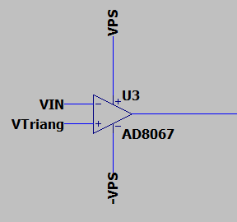
Electrical schematic and theoretically computed values for components
Simple comparator
At every intersection of VIN with VTriang, a switch of the output signal (between VPS and –VPS) happens

Slide 7
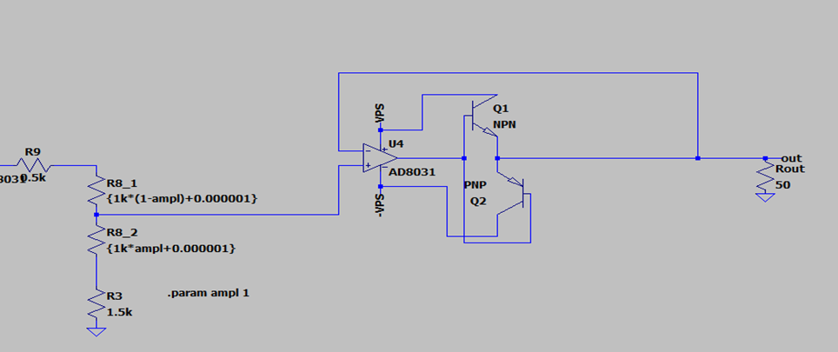
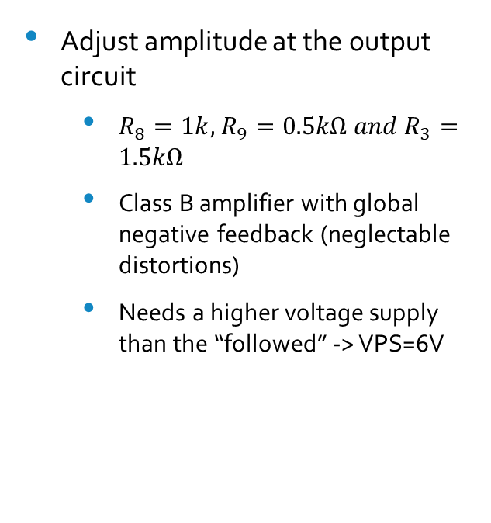
Electrical schematic and theoretically computed values for components
Adjust amplitude at the output circuit
$R_{8}=1k$, $R_{9}=0.5kΩ and R_{3}=1.5kΩ$
Class B amplifier with global negative feedback (neglectable distortions)
Needs a higher voltage supply than the “followed” -> VPS=6V

Slide 8
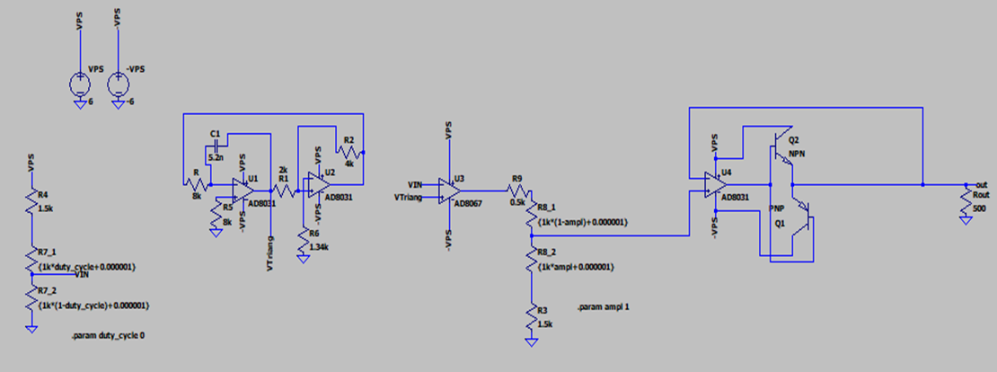
Electrical schematic and theoretically computed values for components
Schematic with theoretically computed values

Slide 9
Choosing standard components
OpAmps
Rail-to-rail AD8031 - triangular signal generator and class B amplifier (slew rate=30V/us), low power amplifier
Rail-to-rail AD8067 – simple comparator (slew rate=640V/us) -> quick stabilization

Slide 10
Choosing standard components
Passive components and transistors
C1=5.1 nF (+/- 10%)
R1=2 kΩ (+/- 0.5%)
R2=4.02 kΩ (+/- 0.05%)
R=R5=8.06 kΩ (+/- 0.5%)
R6=1.35 kΩ (+/- 5%)
R4=1.5 kΩ (+/- 1%)
R7=1 kΩ (+/- 20%)
R9=2 kΩ (+/- 0.1%)
R8=1 kΩ (+/- 20%)
R3=1.5 kΩ (+/- 1%)
Q2=BJT npn 2N2222 (Ic=600 mA)
Q1=BJT pnp 2N2907 (Ic=600 mA)

Slide 11
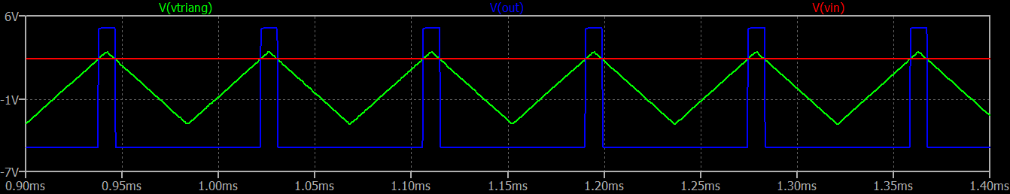
Simulations and Analysis
Time-domain simulation
Amplitude=5V
VIN=2.4V
D=10%
F=11874 Hz

Slide 12
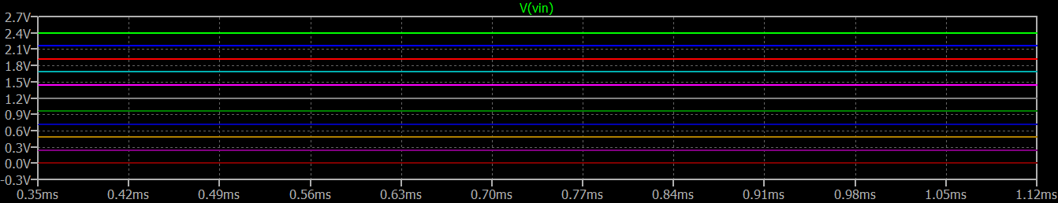
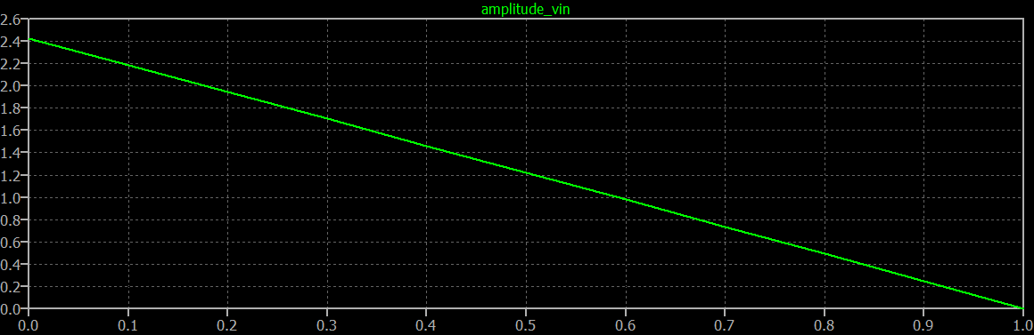
Simulations and Analysis
Parametric analysis – varying duty cycle (potentiometer R7)
VIN variation:
VIN decreases (2.4V-0V) linearly with the increase of the percentage of the used potentiometer

Slide 13
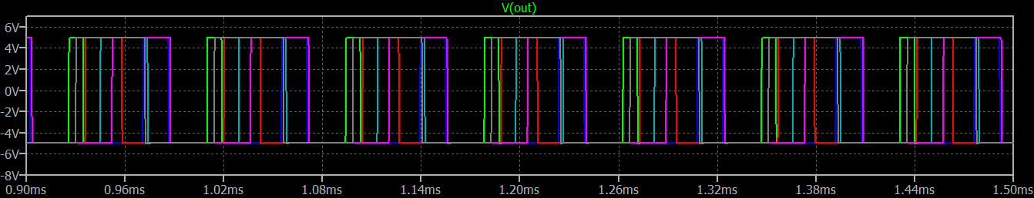
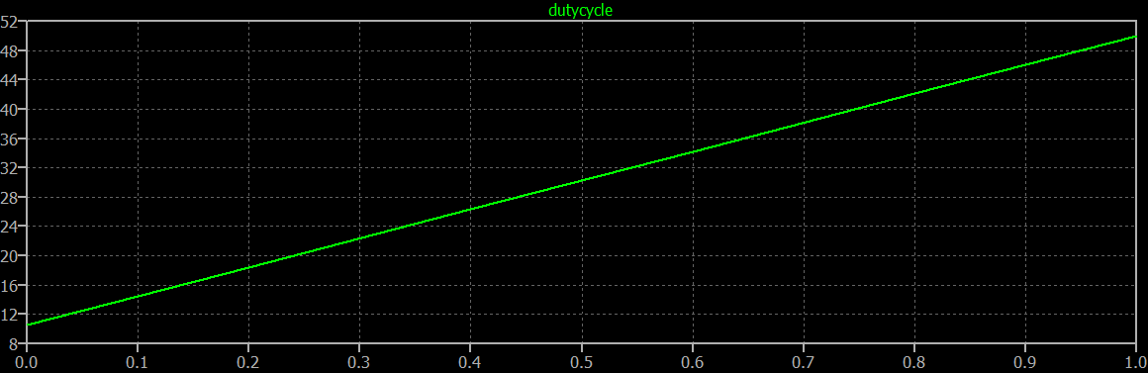
Simulations and Analysis
Parametric analysis – varying duty cycle
Vout variation: (Amplitude=5V)
Duty cycle varies linearly

Slide 14
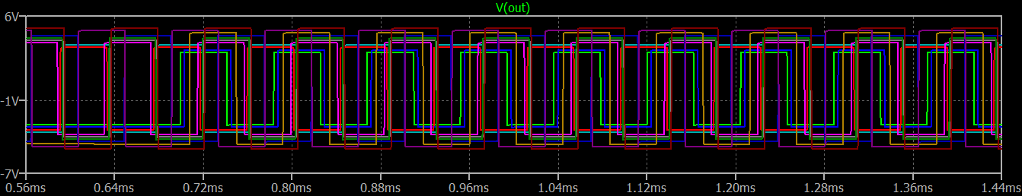
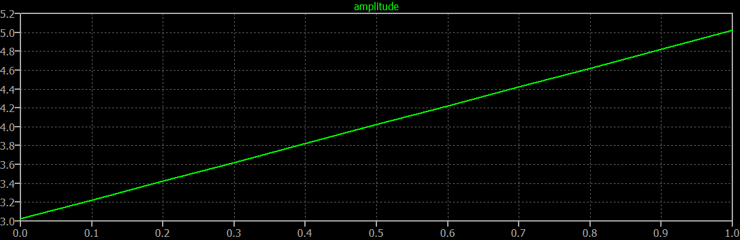
Simulations and Analysis
Parametric analysis – varying amplitude (potentiometer R8)
Vout variation (duty cycle=50%)
Amplitude varies linearly

Slide 15
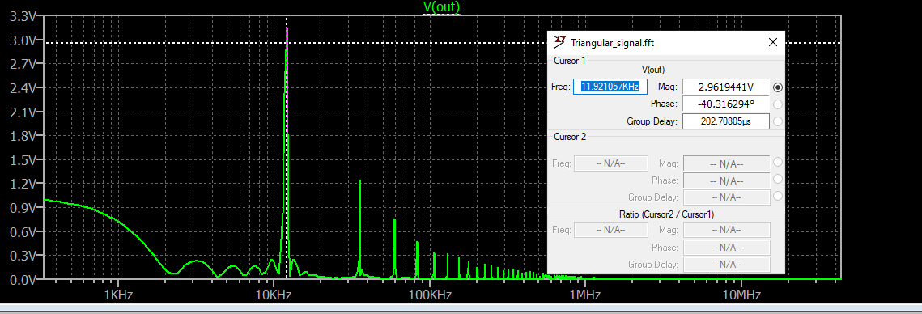
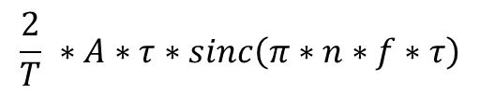
Simulations and Analysis
FFT (Fast Fourier Transform)
Output signal (rectangular)
Ampl=5V, D=50%
$$\frac{2}{T} ∗A∗τ∗sinc\left(π∗n∗f∗τ\right)$$
At f=12kHz => Spectrum = 3.18V

Slide 16
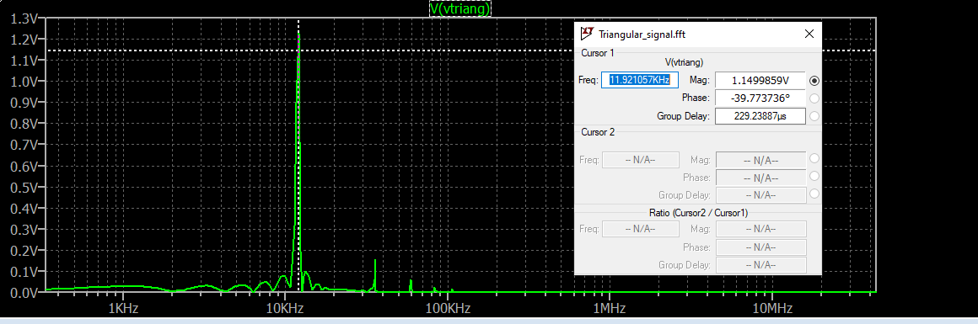
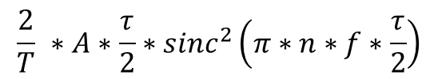
Simulations and Analysis
FFT (Fast Fourier transform)
Triangular signal (Amplitude = 3V):
$$\frac{2}{T} ∗A∗\frac{τ}{2}∗{sinc}^{2}\left(π∗n∗f∗\frac{τ}{2}\right)$$
For f=12kHz => Spectrum = 1.21 V

Slide 17
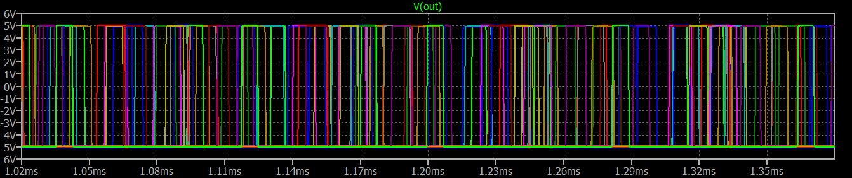
Simulations and Analysis
Monte Carlo analysis
Adding tolerances to the components
Variation of Vout in time (Ampl=5V, D=10%):

Slide 18
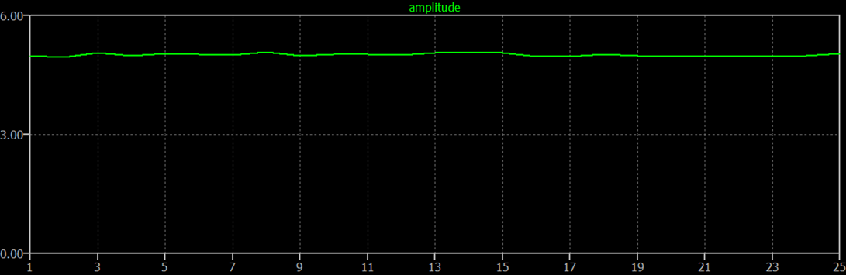
Simulations and Analysis
Monte Carlo analysis
Variation of the amplitude:
Small variation of the amplitude: 4.94V-5.07V

Slide 19
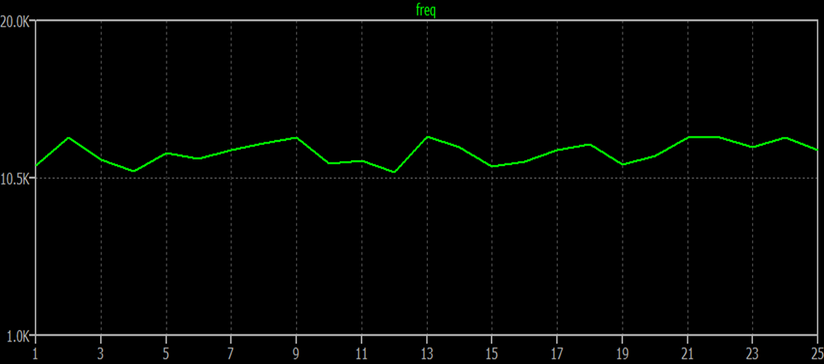
Simulations and analysis
Monte Carlo analysis
Variation of the frequency:
Variation of the frequency: 10.88kHz-13kHz

Slide 20
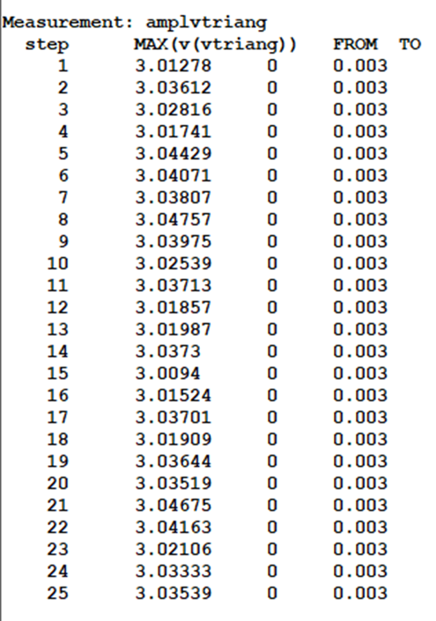
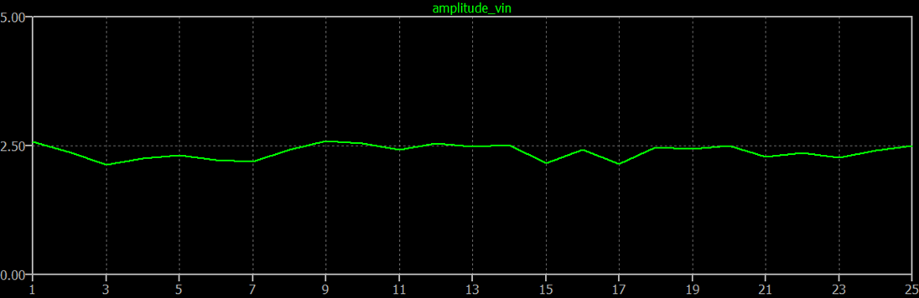
Simulations and analysis
Monte Carlo analysis
Variation of VIN and of the amplitude of the triangular signal:
VIN varies between 2.15V and 2.58 V out of 2.4V
Amplitude Vtriang doesn’t have a significant variation – around 3.02V

Slide 21
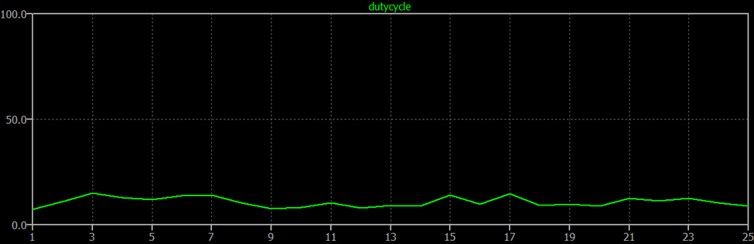
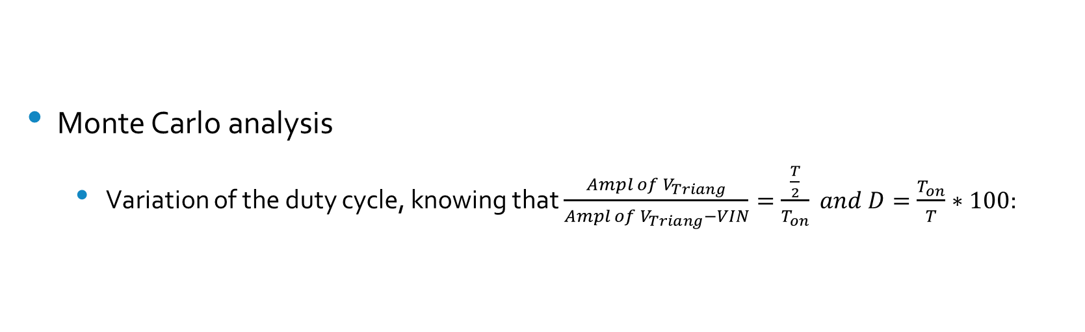
Simulations and analysis
Monte Carlo analysis
Variation of the duty cycle, knowing that $\frac{Ampl of V_{Triang}}{Ampl of V_{Triang}−VIN}=\frac{\frac{T}{2}}{T_{on}} and D=\frac{T_{on}}{T}∗100$:
Duty cycle has a small variation: 7.29%-15% out of 10%

Slide 22
Bill of materials
Nr Crt | Model name | Description | Units | Comp | Price per unit [RON] | Total price [RON]
1 | AD8031ARTZ-REEL7 | Operational Amplifiers - Op Amps SOT23 SINGLE LOW POWER OP AMP | 3 | U1, U2, U4 | 8.86 | 26.58
2 | AD8067ARTZ-REEL7 | Precision Amplifiers High Gain Band Width High Perf Fast FET | 1 | U3 | 18.32 | 18.32
3 | CC0805KRX7R9BB512 | Multilayer Ceramic Capacitors MLCC - SMD/SMT 50V 5100pF X7R 0805 10% | 1 | C1 | 0.09 | 0.09
4 | ERJ-1RHD2001C | Thick Film Resistors - SMD 0201 chip resistor (R=2k) | 1 | R1 | 0.08 | 0.08
5 | RG1608P-4021-W-T5 | Thin Film Resistors - SMD 1/10W 4.02K Ohm .05% 0603 25ppm | 1 | R2 | 0.77 | 0.77
6 | ERJ-6RBD8061V | Thick Film Resistors - SMD 0805 Resistor 0.5% 50ppm 8.06KOhm | 2 | R, R5 | 0.08 | 0.08
7 | RT0603DRE071K35L | Thin Film Resistors - SMD 1/10W 1.35K Ohms .5% | 1 | R6 | 0.05 | 0.05
8 | 302-1.5K-RC | Thick Film Resistors - SMD 1/10WATT 1.5KOHMS | 2 | R4, R3 | 0.005 | 0.01
9 | P160KN-0QC15B1K | Potentiometers 1/5W 1K Ohms 20% 16mm ROTARY POT | 2 | R7, R8 | 2.53 | 5.06
10 | RN732ATTD5000B25 | Thin Film Resistors - SMD 500Ohm,0805,0.1%,25p | 1 | R9 | 0.52 | 0.52
11 | 2N2222A | Bipolar Transistors - BJT Bipolar Transistor, TO-92, 40V, 600mA, NPN | 1 | Q2 | 0.39 | 0.39
12 | 2N2907A | Bipolar Transistors - BJT Bipolar Transistor, TO-92, 60V, 600mA, PNP | 1 | Q1 | 0.39 | 0.39
TOTAL |  |  |  |  |  | 52.34

Slide 23
References
https://www.circuitsgallery.com/pwm-generator-circuit-using-741-op-amp/
https://www.sciencedirect.com/topics/engineering/pulse-width-modulation
https://electronicspost.com/generation-and-detection-of-a-pwm-signal/
http://www.bel.utcluj.ro/dce/didactic/fec/22_power_amplifier_class_D.pdf
http://www.bel.utcluj.ro/dce/didactic/fec/20_nonsinusoidal_oscillators.pdf
http://www.bel.utcluj.ro/dce/didactic/fec/
AD8067 (Rev. B) (analog.com)
AD8031/AD8032 (Rev. G) (analog.com)
Teoria Semnalelor (utcluj.ro)
Electronic Components Distributor - Mouser Electronics Romania

